Slide 1
SS ZG653 (RL 8.3): Software Architecture Introduction to Unified Process
Instructor: Prof. Santonu Sarkar

Slide 2
What is (Rational) Unified Process
While UML provided the necessary technology for OO software design
Unified process gives a framework to build the software using UML
Iterative approach
Five main phases
Inception
Establish a justification and define project scope
Outline the use cases and key requirements that will drive the design tradeoffs Outline one or more candidate architectures
Identify risks and prepare a preliminary project schedule alongwith cost estimate
Elaboration (Architecture and Design)
Construction (Actual implementation)
Transition (initial release)
Production (Actual deployment)
Rumbaugh, Booch, Jacobson

Slide 3
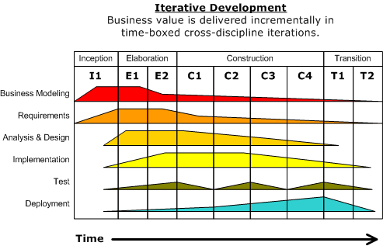
Architecture Activities
Architecture Focused all the time
Starts during inception and described in detail during the elaboration phase
"Development-iterative" by Dutchguilder - Own work. Licensed under Public Domain via Commons –
https://commons.wikimedia.org/wiki/File:Development-iterative.png#/media/File:Development-iterative.png

Slide 4
Feature Driven Design
Starts during Inception-Elaboration Phase
Mostly used in the context of Agile development
The requirement is modeled as a set of features
A feature is a client-valued functionality that can be implemented and demonstrated quickly
‘Feature’ template <action> the <result> (by|for|of|to) a(n) <object>
Add a product to a shopping-cart
Store the shipping-information for the customer

Slide 5
From Feature to Architecture
Once a set of features are collected
Similar features are grouped together into a module
Set of clusters created out of the features, forms a set of modules
This becomes the basic Module Structure
Recall the software architecture and views…

Slide 6
Use-case Model
Use-cases are used to describe an usage scenario from the user’s point of view
Create a basic use-case diagram
Elaborate each use-case
To create Use-Case
Define actors (who will use this use-case)
Describe the scenario
Preconditions
Main tasks
Exceptions
Variation in the actors interaction
What system information will the actor acquire, produce or change?
Will the actor have to inform about the changes?
Does the actor wish to be informed about any unexpected changes?

Slide 7
First step towards Module Views
Analysis Classes are not the final implementation level classes. They are more coarse grained. They are typically modules. They manifest as
External Entities
Other systems, devices that produce or consume information related to this system
Things
Report, letters, signals
Structure
Sensors, four-wheeled car,… that define a class of objects

Slide 8
Analysis Classes manifest as…
Event Occurrences
Transfer of fund, Completion of Job
Roles
People who interact with the systems (Manager, engineer, etc.)-- Actors
Organizational Units
Divisions or groups that are important for this system
Places
Location that establish the context of the overall functionality of the system

Slide 9
How to get these classes?
Get the noun phrases. They are the potential objects.
Apply the following heuristics to get a legitimate analysis class
It should retain information for processing
It should have a set of identifiable operations
Multiple attributes should be there for a class
Operations should be applicable for all instances of this class
Attributes should be meaningful for all instances of this class

Slide 10
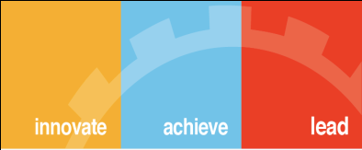
Thank You

